Slide 1
Computational Complexity
计算复杂性
Lecture 12. Randomness

Slide 2
Chapter 6 Randomness and Counting
The Power of Randomness
运用随机化可以得到有效算法
Randomized complexity classes
BPP, RP,co-RP, ZPP
Polynomial Identity Testing is in coRP
Randomized Log-Space
Counting Problems

Slide 3
Communication complexity
two parties: Alice and Bob
function f:{0,1}^{n} x {0,1}^{n} → {0,1}
Alice holds x ∈ {0,1}^{n}; Bob holds y ∈ {0,1}^{n}
Goal: compute f(x, y) while communicating as few bits as possible between Alice and Bob
count number of bits exchanged (computation free)
at each step: one party sends bits that are a function of held input and received bits so far

Slide 4
Communication complexity
simple function (equality):
EQ(x, y) = 1 iff x = y
simple protocol:
  Alice sends x to Bob (n bits)
  Bob sends EQ(x, y) to Alice (1 bit)
  total: n + 1 bits
  (works for any predicate f)

Slide 5
Communication complexity
Can we do better?
  deterministic protocol?
  probabilistic protocol?
    at each step: one party sends bits that are a function of held input and received bits so far and the result of some coin tosses
    required to output f(x, y) with high probability over all coin tosses

Slide 6
Communication complexity
Theorem: no deterministic protocol can compute EQ(x, y) while exchanging fewer than n+1 bits.

Slide 7
Communication complexity
protocol for EQ employing randomness?
  Alice picks random prime p in {1...4n²}, sends:
    p
    (x mod p)
  Bob sends:
    (y mod p)
  players output 1 if and only if:
  (x mod p) = (y mod p)

Slide 8
Communication complexity
  O(log n) bits exchanged
  if x = y, always correct
  if x ≠ y, incorrect if and only if:
  p divides |x – y|
  # primes in range is ≥ 2n
  # primes dividing |x – y| is ≤ n
  probability incorrect ≤ 1/2
Randomness gives an exponential advantage!!

Slide 9
Communication complexity
two parties: Alice and Bob
function f:{0,1}^{n} x {0,1}^{n} → {0,1}
Alice holds x ∈ {0,1}^{n}; Bob holds y ∈ {0,1}^{n}
Goal: compute f(x, y) while communicating as few bits as possible between Alice and Bob
Example: EQ(x, y) = 1 iff x = y
Deterministic protocol: no fewer than n+1 bits
Randomized protocol: O(log n) bits

Slide 10
另一个例子：计算DLP
Discrete Log Problem
G is a finite cyclic group
g, h are members of G such that <g> generates G (G = {g, g², g³, g⁴…g^{n} = 1}
n is the order of g
Find x such that h = g^{x}

Slide 11
Why Study the DLP?
Several cryptographic and signature algorithms/methods like
  Diffie-Hellman key exchange protocol
  US Government’s Digital Signature Algorithm (DSA) and elliptic curve version (ECDSA)
rely on the fact that it is hard.

Slide 12
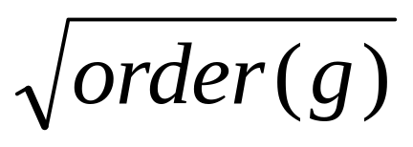
Initial Methods
Exhaustive search
  Run time: O(|G|)
  Space requirement: O(1)
Shank’s Baby Step-Giant Step Method (1971)
  Run time: O( )
  Space requirement: O( )

Slide 13
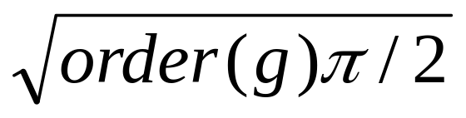
Pollard’s Rho Method (1975)
The Rho method relies on the birthday paradox.
Elements drawn at random from <g> then the expected number of draws before an element is drawn twice (a collision) is
Define a random walk on <g> consisting of elements of the form g^{e}h^{d} for known e and d, wait for a collision with e’ and d’ such that g^{e}h^{d} = g^{e’}h^{d’} and compute log_{g} h = (e – e’)/ (d’ –d) mod order(g).
Notes:
10000, 5000, 100

Slide 14
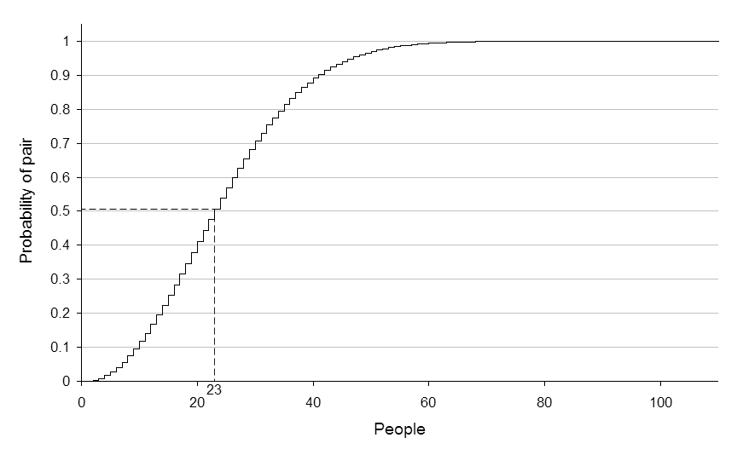
Birthday Paradox Problem
60 people translates to a 99% probability

Slide 15
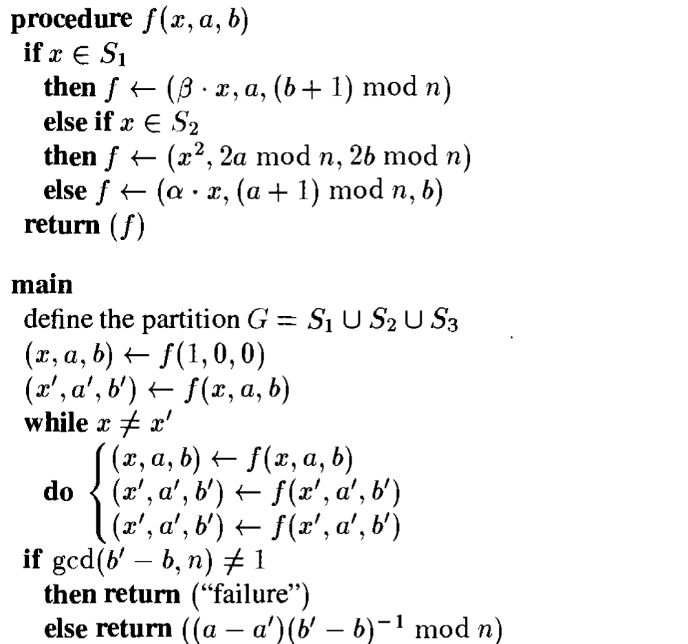
Pollard’s Rho Algorithm (G, n,α,β )

Slide 16
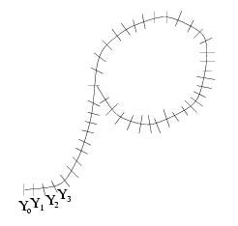
Pollard’s Rho Method
g^{e}h^{d} = g^{e’}h^{d’}

Slide 17
Randomized complexity classes
model: probabilistic Turing Machine
  deterministic TM with additional read-only tape containing “coin flips”
input tape
…
0
1
1
0
0
1
1
1
0
1
0
0
finite control
read/write head
q₀
read head
…
0
1
1
0
0
1
1
1
0
1
0
0
Notes:
概率图灵机，每一步恰有2个选择0,1，并根据最后输出中接受所占的比例决定是否接受。

Slide 18
概率图灵机是一种非确定性图灵机，它根据概率分布在每个点的可用转换之间随机选择。 这意味着概率图灵机可以有随机结果。 在相同的输入上，它可能有不同的运行时间，一次接受它，另一次拒绝。 它也永远不会停止。 这个图灵机引出了其他复杂类，如RP，ZPP和BPP。

Slide 19

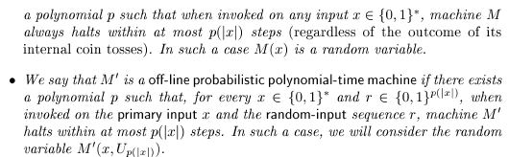
Notes:
在线：随着计算的开始，图灵机进入随机化步骤，允许图灵机每步计算做均匀的随机选取。
脱线：用一个随机数作为一个额外输入

Slide 20
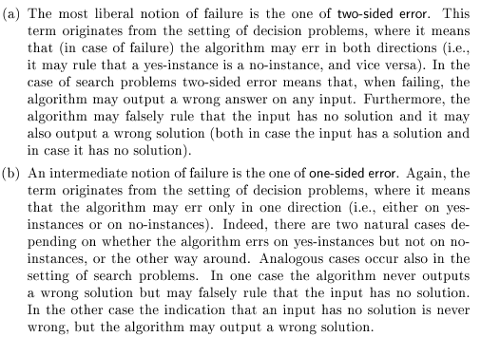


Slide 21
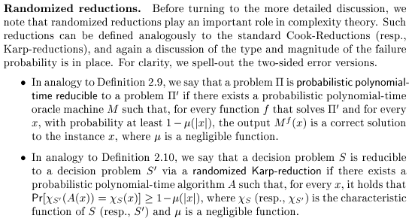
随机化规约

Slide 22
Probabilistic polynomial-time
PP is the class of decision problems solvable by a probabilistic Turing machine in polynomial time, with an error probability of less than 1/2 for all instances.
If a decision problem is in PP, then there is an algorithm for it that is allowed to flip coins and make random decisions.It is guaranteed to run in polynomial time. If the answer is YES, the algorithm will answer YES with probability more than 1/2. If the answer is NO, the algorithm will answer YES with probability at most 1/2.
J. Gill, "Computational complexity of probabilistic Turing machines." SIAM Journal on Computing, 6 (4), pp. 675–695, 1977

Slide 23
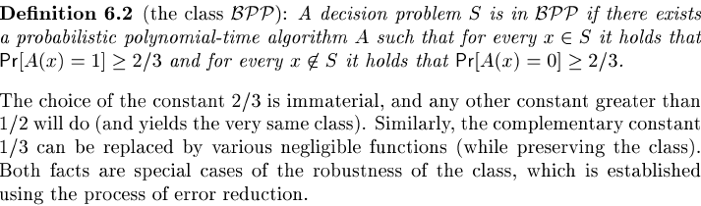
BPP
BPP是在多项式时间内以概率图灵机解出的问题的集合, 并且对所有的输入，输出结果有错误的概率在1/3之内。BPP这个简写代表"Bounded-error"(有限错误)，"Probabilistic"(机率的)，"Polynomial time"(多项式时间)。

Slide 24
Error reduction for BPP
BPP定义是输出结果有错误的概率在1/3之内，即成功（无错）概率是大于2/3。实际上只要成功概率大于1/2即可，并可以将成功概率无限逼近到1。
given L, and p.p.t. TM M:
  x ∈ L ⇒ Pr_{y}[M(x,y) accepts] ≥ ½ + ε
  x ∉ L ⇒ Pr_{y}[M(x,y) rejects] ≥ ½ + ε
new p.p.t. TM M’:
  simulate M k/ε² times, each time with independent coin flips
  accept if majority of simulations accept
  otherwise reject

Slide 25
Error reduction for BPP
  X_{i} random variable indicating “correct” outcome in i-th simulation (out of m = k/ε² )
    Pr[X_{i} = 1] ≥ ½ + ε
    Pr[X_{i} = 0] ≤ ½ - ε
  E[X_{i}] ≥ ½+ε
  X = Σ_{i}X_{i}
  μ = E[X] ≥ (½ + ε)m
  Chernoff: Pr[X ≤ m/2] ≤ 2^{-Ω(ε2 μ)}

Slide 26
Error reduction for BPP
  x ∈ L ⇒ Pr_{y}[M(x,y) accepts] ≥ ½ + ε
  x ∉ L ⇒ Pr_{y}[M(x,y) rejects] ≥ ½ + ε
  if x ∈ L
  Pr_{y’}[M’(x, y’) accepts] ≥ 1 – (½)^{Ω(k)}
  if x ∉ L
  Pr_{y’}[M’(x,y’) rejects] ≥ 1 – (½)^{Ω(k)}

Slide 27

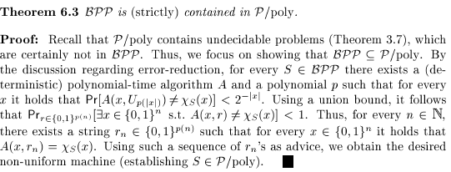
Adleman’s Theorem

Slide 28
BPP and Boolean circuits
Proof:
  Problem L ∈ BPP
  error reduction gives TM M such that
    if x ∈ L of length n
  Pr_{y}[M(x, y) accepts] ≥ 1 – (½)^{n2}
    if x ∉ L of length n
  Pr_{y}[M(x, y) rejects] ≥ 1 – (½)^{n2}

Slide 29
BPP and Boolean circuits
  say “y is bad for x” if M(x,y) gives incorrect answer
  for fixed x: Pr_{y}[y is bad for x] ≤ (½)^{n2}
  Pr_{y}[y is bad for some x] ≤ 2^{n}(½)^{n2}< 1
  Conclude: there exists some y on which M(x, y) is always correct
  build circuit for M, hardwire this y

Slide 30
BPP and Boolean circuits
Does BPP = EXP ?
Adleman’s Theorem shows:
BPP = EXP implies EXP ⊂ P/poly
If you believe that randomness is all-powerful, you must also believe that non-uniformity gives an exponential advantage.

Slide 31
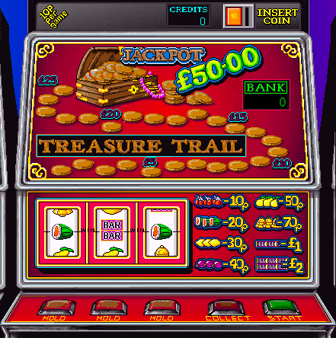
One-Sided Error
Note that if the right answer is ‘NO’, we clearly answer ‘NO’.
Thus, a random walk algorithm has one-sided error.
Such algorithms are called “Monte-Carlo” algorithms.

Slide 32
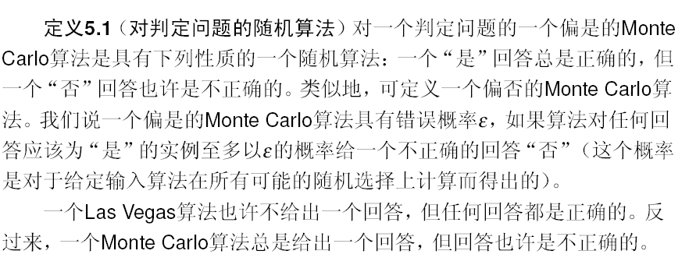

Slide 33
One-side error:
Randomized complexity classes
RP (Random Polynomial-time)
  L ∈ RP if there is a p.p.t. TM M:
  x ∈ L ⇒ Pr_{y}[M(x,y) accepts] ≥ ½
  x ∉ L ⇒ Pr_{y}[M(x,y) rejects] = 1
coRP (complement of Random Polynomial-time)
  L ∈ coRP if there is a p.p.t. TM M:
  x ∈ L ⇒ Pr_{y}[M(x,y) accepts] = 1
  x ∉ L ⇒ Pr_{y}[M(x,y) rejects] ≥ ½

Slide 34
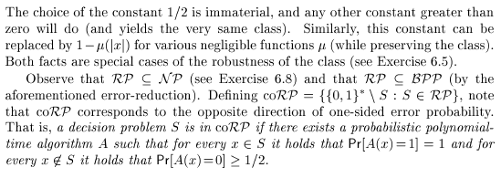

Slide 35


Slide 36
Zero-side error:
One more important class:
ZPP (Zero-error Probabilistic Poly-time)
  ZPP = RP ∩ coRP
  Pr[A(x) outputs “┴”] ≤ ½
  otherwise outputs correct answer

Slide 37
Randomized complexity classes
These classes may capture “efficiently computable” better than P.
“1/2” in ZPP, RP, coRP definition unimportant
  can replace by 1/poly(n)
“2/3” in BPP definition unimportant
  can replace by ½ + 1/poly(n)
Why? error reduction
  we will see simple error reduction by repetition
  more sophisticated error reduction later

Slide 38
Error reduction for RP
given S and p.p.t A:
  x ∈ S ⇒ Pr[A(x)=1] ≥ ε
  x ∉ S ⇒ Pr[A(x)=0] = 1
new p.p.t A’:
  simulate A k/ε times, each time with independent coin flips
  accept if any simulation accepts
  otherwise reject

Slide 39
Error reduction
  x ∈ S ⇒ Pr[A(x)=1] ≥ ε
  x ∉ S ⇒ Pr[A(x)=0] = 1
if x ∈ S:
  probability a given simulation “bad” ≤ (1 – ε)
  probability all simulations “bad” ≤ (1–ε)^{(k/ε)} ≤ e^{-k}
  Pr_{y’}[M’(x, y’) accepts] ≥ 1 – e^{-k}
if x ∉ L:
  Pr_{y’}[M’(x,y’) rejects] = 1

Slide 40
Relationship to other classes
all these classes contain P
  they can simply ignore the tape with coin flips
all are in PSPACE
  can exhaustively try all strings y
  count accepts/rejects; compute probability
RP ⊂ NP (and coRP ⊂ coNP)
  multitude of accepting computations
  NP requires only one

Slide 41
RP,coRP, BPP
ZPP
coRP
P
RP
PSPACE
BPP
EXP
from definitions: ZPP ⊂ RP, coRP ⊂ BPP

Slide 42
Relationship to other classes
PSPACE
BPP
NP
coNP
RP
coRP
P

Slide 43
Polynomial identity testing
Given: polynomial p(x₁, x₂, …, x_{n}) as arithmetic formula (fan-out 1):
*
multiplication (fan-in 2)
addition (fan-in 2)
negation (fan-in 1)
-
*
*
+
-
x₁
x₂
x₃
…
x_{n}

Slide 44
Polynomial identity testing
Question: Is p identically zero?
  i.e., is p(x) = 0 for all x ∈ F^{n}
  (assume |F| larger than degree…)
“polynomial identity testing” because given two polynomials p, q, we can check the identity p ≡ q by checking if (p – q) ≡ 0

Slide 45
Polynomial identity testing
try all |F|^{n} inputs?
  may be exponentially many
multiply out symbolically, check that all coefficients are zero?
  may be exponentially many coefficients
Best known deterministic algorithm places in EXP

Slide 46
Polynomial identity testing
Lemma (Schwartz-Zippel): Let
p(x₁, x₂, …, x_{n})
be a total degree d polynomial over a field F and let S be any subset of F. Then if p is not identically 0,
Pr_{r1,r2,…,rn∈S}[ p(r₁, r₂, …, r_{n}) = 0] ≤ d/|S|.

Slide 47
Polynomial identity testing
Given: polynomial p(x₁, x₂, …, x_{n}) over field F
Is p identically zero?
Note: degree d is at most the size of input
*
-
*
*
+
-
x₁
x₂
x₃
…
x_{n}

Slide 48
Polynomial identity testing
randomized algorithm: pick a subset S ⊂ F of size 2d
  pick r₁, r₂, …, r_{n} from S uniformly at random
  if p(r₁, r₂, …, r_{n}) = 0, answer “yes”
  if p(r₁, r₂, …, r_{n}) ≠ 0, answer “no”
if p identically zero, never wrong
if not, Schwartz-Zippel ensures probability of error at most ½

Slide 49
Randomized complexity classes
We have shown:
  Polynomial Identity Testing is in coRP
  note: no sub-exponential time deterministic algorithm know

Slide 50
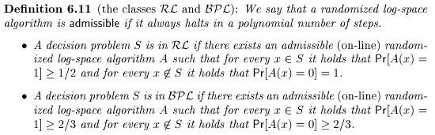
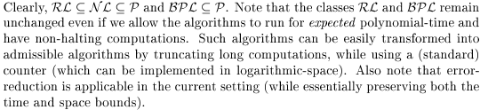
Randomized Log-Space

Slide 51
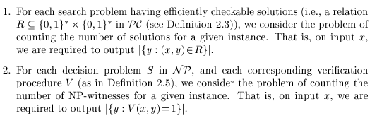

Counting Problems

Slide 52
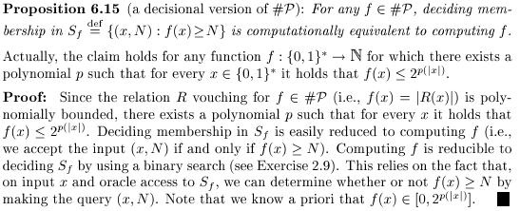

Slide 53
